Slide 1

MnDOT
Storage Tanks
Aboveground & Underground Environmental Compliance
Summer Allen-Murley
Office of Environmental Stewardship
2019

Slide 2
Objectives
Distinguish types of aboveground and underground storage tanks
Recognize tank requirements
Identify tasks required

Slide 3
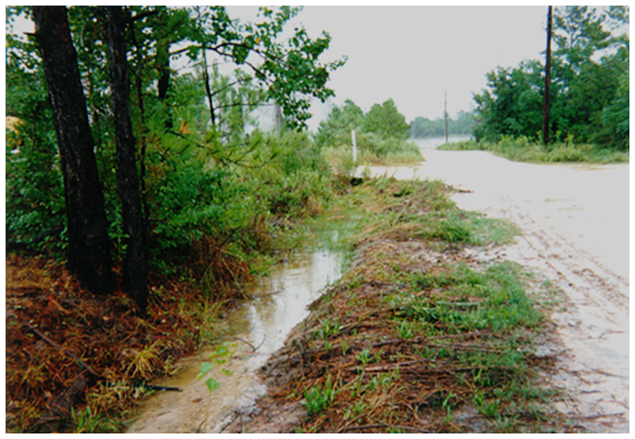
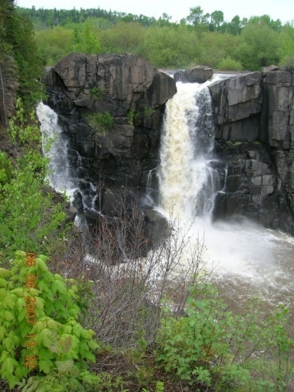
Do MPCA regulations apply?
Yes
If tank contains a liquid that could pollute the waters (ground or surface) of the state
Notes:
Regulations apply to owners or operators of an aboveground storage tank (AST) that stores a substance that would likely pollute any waters of the state. This includes groundwater and surface water.
Substances include petroleum products, hazardous materials, or “other regulated substances” (such as salt brine, soybean oil or molasses) that are liquid at ambient pressure and temperatures.

Slide 4
Aboveground Storage Tanks (ASTs):
What we’ll cover
Types of ASTs
Registration
Labeling
Secondary containment
Substance transfer safeguards
Leak detection
Corrosion protection & options
Overfill protection
Maintenance
Record Keeping

Slide 5
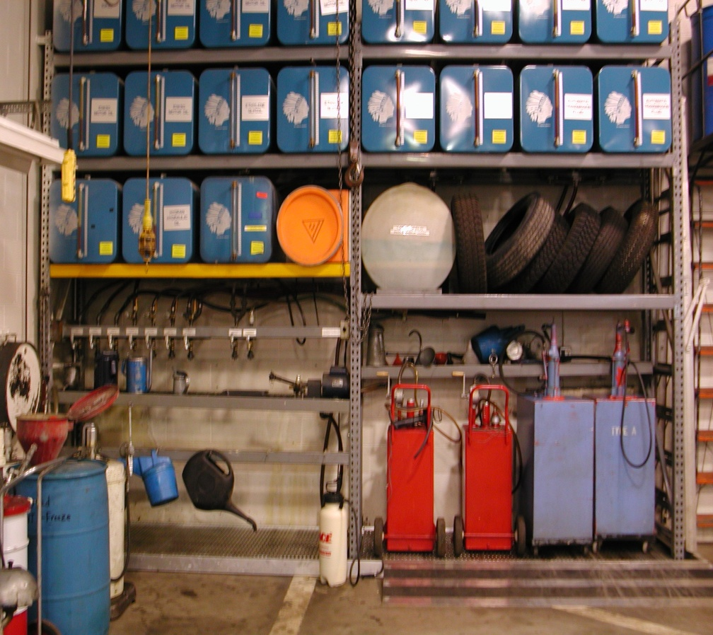
Types of Aboveground Storage Tanks
Exempt (with certain restrictions)
Partially regulated
Fully regulated
Notes:
Exempt tanks - Some tanks are exempt from registration requirements according to Minnesota Statutes, Chapter 116.47. Some tanks are exempt from Minnesota Rules, Chapter 7151. It is important to determine if tanks are exempt from registration requirements, rule requirements, or both.
Fully regulated tanks - These are, normally, tanks greater than 1,100 gallons containing hazardous substances or petroleum.
Partially regulated tanks - These are small tanks near surface water and temporary tanks.

Slide 6
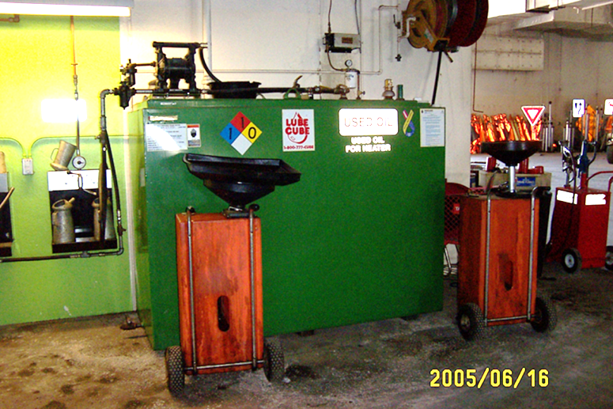
MnDOT Exempt Tanks
Reasonable safeguards to control tank releases must be present at the facility, such as a spill kit.
Equipment (heating/hydraulic/generator)
Tanks storing non-liquid materials (propane)
Tote (tanks not refilled on site and located on site for less than 180 days)
Transport*
Indoor Tank*
Water
*certain conditions apply
Notes:
The following tanks are exempt from Aboveground Storage Tank (AST) Rules:
Equipment or machinery containing substances for operational procedures such as fuel tanks on vehicles, heating, hydraulic lifts, and emergency generators.
Tote tanks which include tanks that are not filled or refilled on site; are 1,100 gallons or less in capacity; and are on site less than 180 days.
*A vehicle, such as a tank truck, designed to transport substances if: 1) on site for less than 30 days and 2) not emptied or refilled on site
*Indoor tanks if: 1) the tank has its own secondary containment; 2) the tank contents will not escape the building; or 3) a release would be directed to a permitted treatment facility
Surface impoundment, pit, pond, or lagoon
Water tanks
Small tanks that are greater than 500 feet from surface water

Slide 7
MnDOT Partially Regulated Tanks
Temporary Tanks (located at a site for more than 30 days but less than 1 year)
Tanks Storing “Other Regulated Substance” (deicers)
Tanks between 500 – 1,100 gallons near surface water
Notes:
Surface water: protects all MN waters that may be used for any recreational purpose (lakes, streams, ditches)

Slide 8
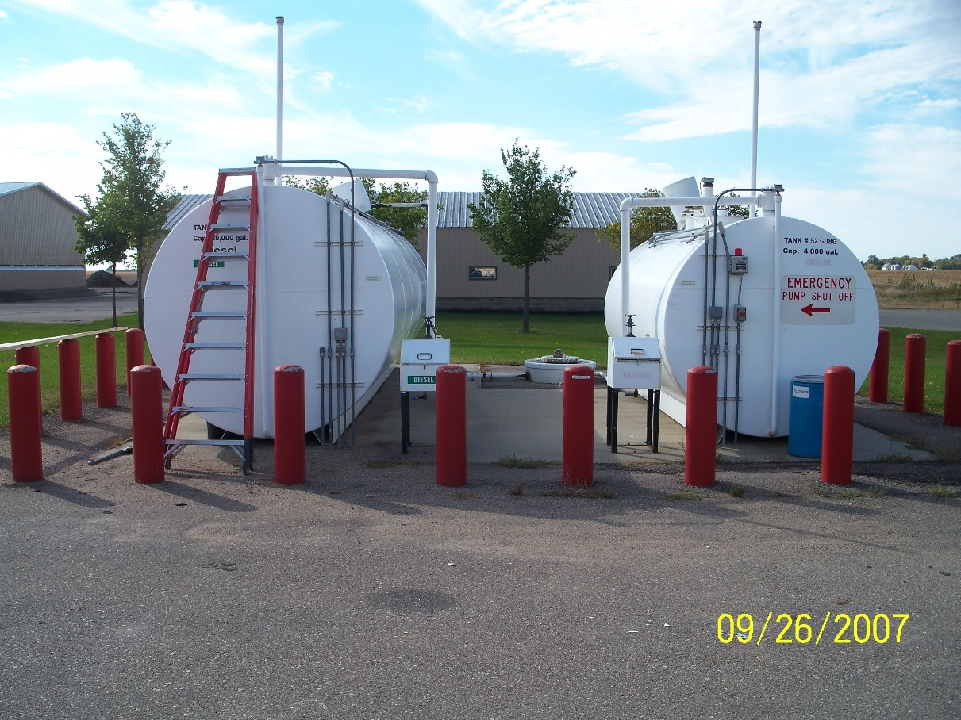
MnDOT Fully Regulated Tanks
Everything else

Slide 9
MPCA AST Registration
Greater than 500 gallon petroleum tank?
Any size deicer/salt brine?
Register!
Notes:
All tanks greater than 500 gallons must be registered with the MPCA if they contain hazardous substances or petroleum products. Exemptions from the registration requirements can be found in the following slides or Minnesota Statutes, Chapter 116.47. Exemption from registration does not guarantee exemption from the rules.
Any size deicer or salt brine tanks must be registered. MnDOT policy.
MPCA has made a policy decision that “temporary tanks” don’t have to be registered. However, these tanks are subject to Minnesota Rules, Chapter 7151. Temporary tanks are tanks at a site for more than 30 days, but less than a year.

Slide 10

How to Register
Notify the MPCA
within 30 days
of installation or
change of status
AST Notification Form
Age
Size
Type
Location
Use
Contents
Safeguards
Notes:
Notify the MPCA within 30 days of installing, removing, or changing the product of the tank.
Use MPCA form entitled “Notification/Change in Status for Aboveground Storage Tanks” located on the Internet at http://www.pca.state.mn.us/cleanup/ast.html
You will be asked to provide: tank age, size (capacity), type, location, use, contents, and safeguards.

Slide 11
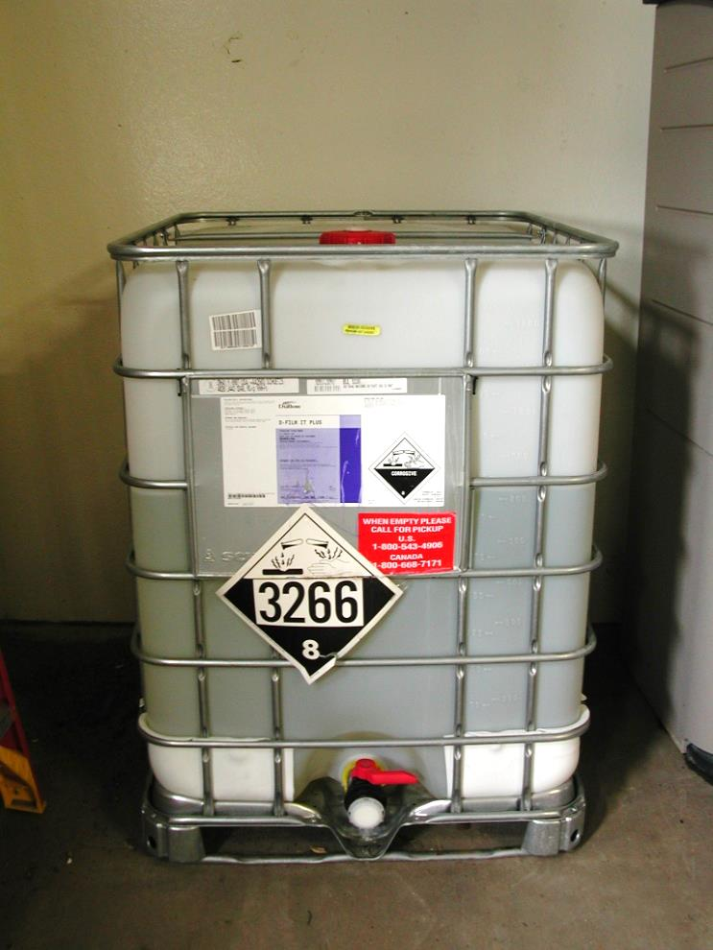
MnDOT Tanks exempt from registration
Septic & Wastewater
Temporary, < 30 days in 1 year
Tote

Slide 12
Labeling
1
Label tanks
Label lines
Post signs
Petroleum over 500 gallons and all deicer tanks
Number
Capacity
Contents
Owner/Operator
-Name
-Address
-Phone #
OR
Emergency #
Notes:
Exemptions: equipment, indoor tank, hydraulic

Slide 13
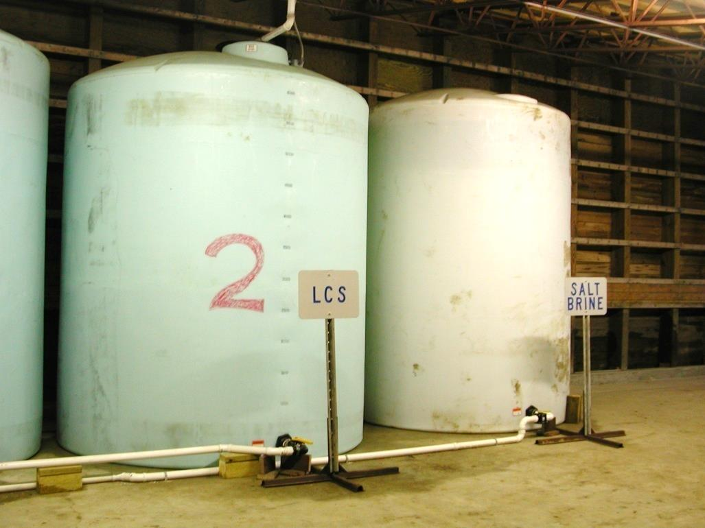
Provide secondary containment
Must contain at least 100% containment, 110% if outdoors
Product and containment must be compatible
Requires leak detection below the floor of the tank
  Interstitial monitoring or
  Visual
Needs to be constructed of listed materials and designed, inspected, and certified by a P.E.

Slide 14
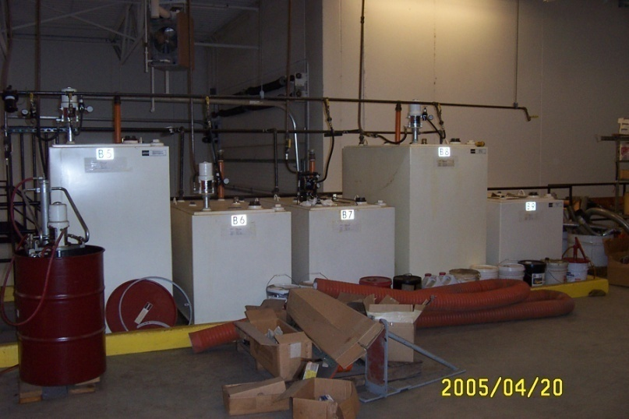
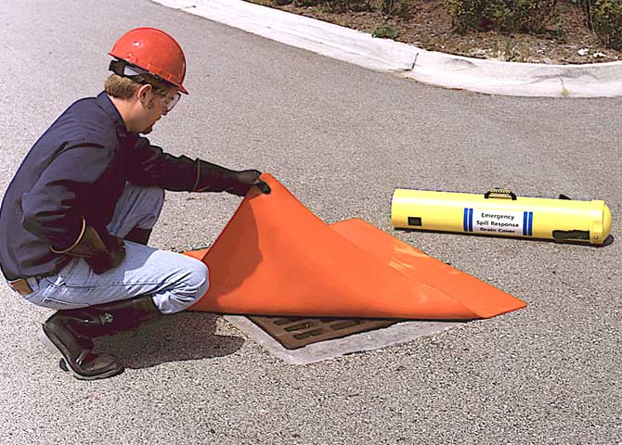
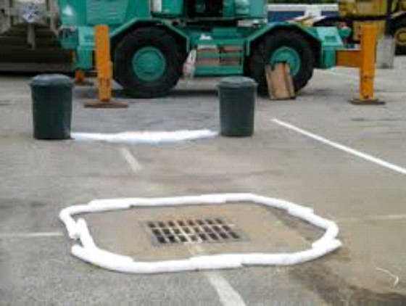
Provide secondary containment
Double-wall on tank
Concrete curb
Synthetic membrane or berm
Notes:
Other acceptable types of non-soil secondary containment for new and existing tanks includes:
geosynthetic clay liner
fabricated steel
fiberglass
other MPCA-approved method

Slide 15
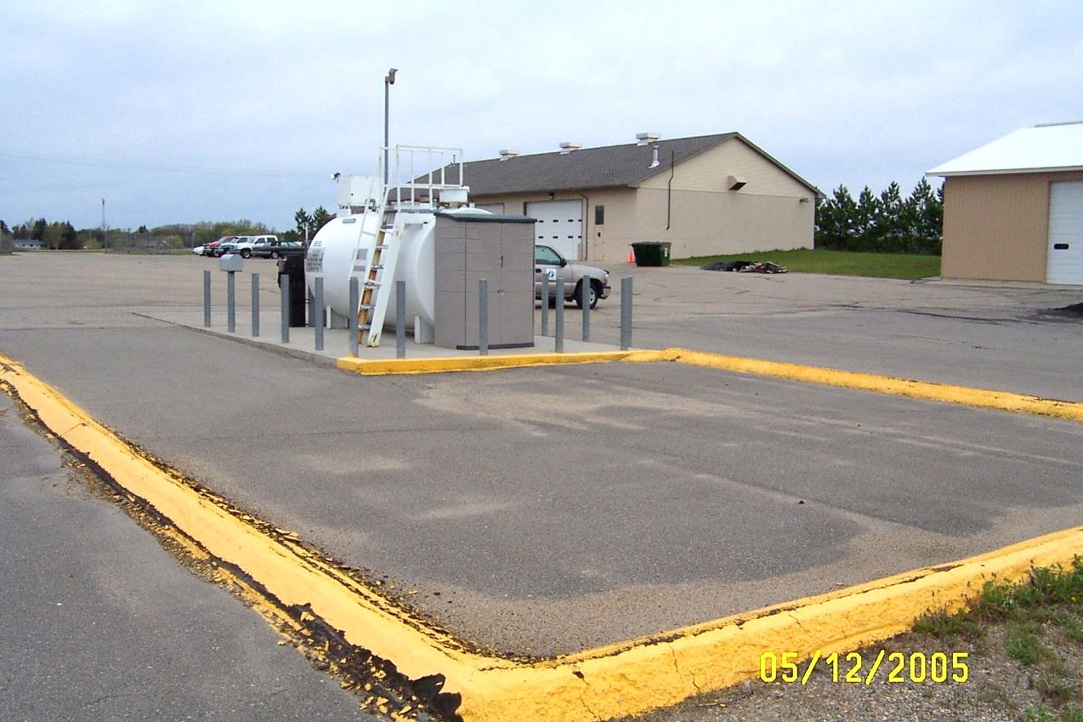
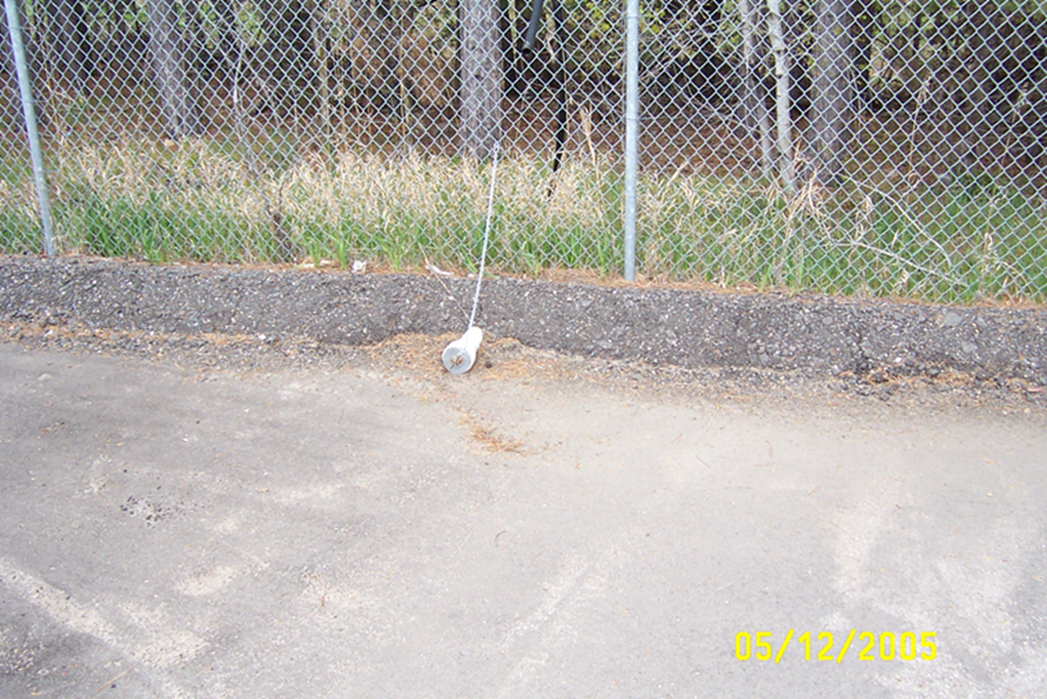
Provide substance transfer safeguards for petroleum
ASTs > 1,100 gallons or all tanks if under SPCC
Notes:
Curbing, spill kits

Slide 16
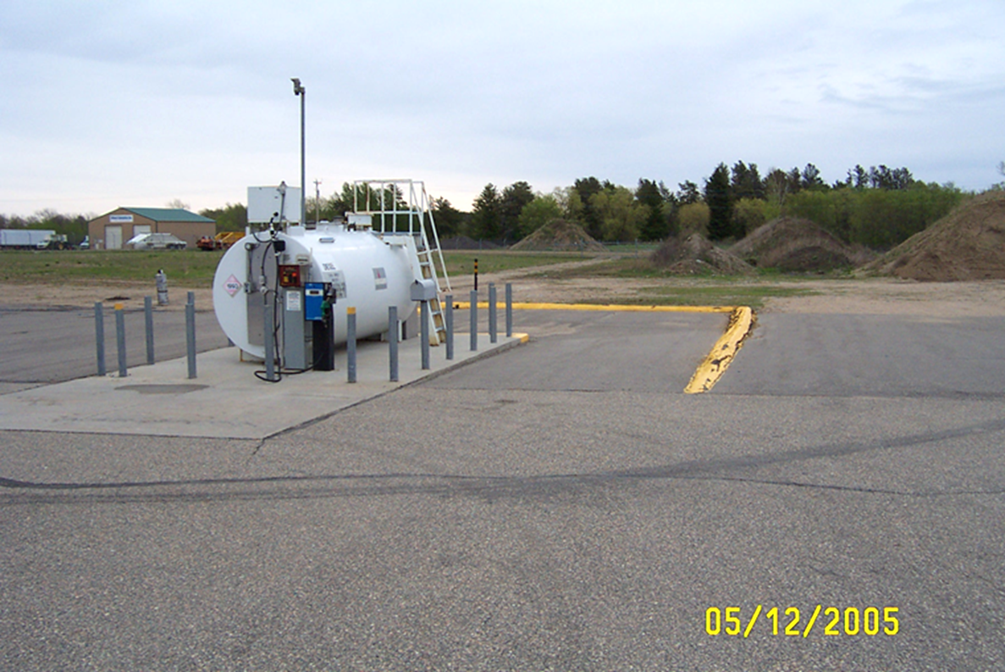
Substance transfer safeguards
Required
Spill box or
Adequate containment volume area
If under SPCC, area must contain 100% or 110% release of largest vehicle compartment
Designed, inspected, and certified by a P.E.
Notes:
The volume for the substance transfer area according to Minn. Rules, Ch. 7151 must provide “adequate” containment at the connection point of the transfer vehicle and at the connection point on the tank.
If ASTs are subject to federal Spill Prevention Control and Countermeasures (SPCC) regulation, the transfer area must contain the largest compartment of the vehicle performing the product transfer. If outdoors, plus 10% more for precipitation.

Slide 17
Substance transfer safeguards
Excluded
ASTs:
  Filled with hand-held nozzles
  Temporary
  Transfers through continuous pipelines between tanks at one site
  Capacity 1,100 gallons or less, unless under Federal Spill Plan (SPCC)
  Holding deicers

Slide 18
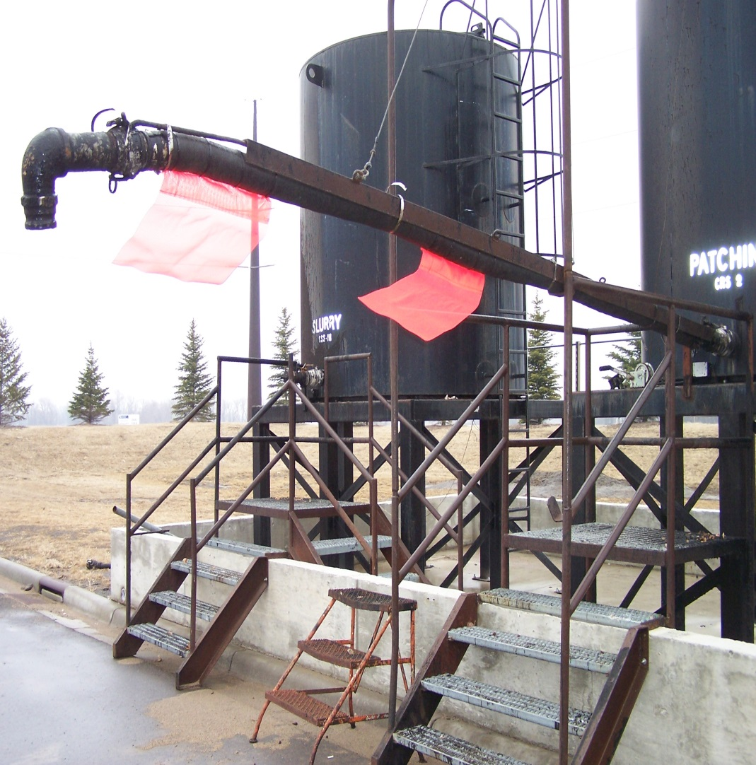
Leak detection monitoring
Over 1100 gallons of any product:
Monthly on outdoor double-walled tanks
Weekly on outdoor contained single-walled (photo)
Keep records
Notes:
Visual check of interstitial space or containment area including tank, piping, hoses, pumps.
Note: Some tank systems are exempt from inspection by state rule but may still be required if facility is under the federal spill plan

Slide 19
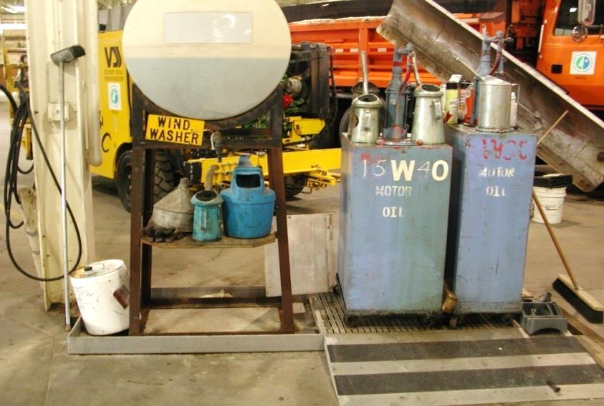
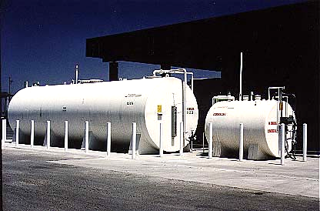
Corrosion Protection for Tanks
1
Elevate tank
Place on concrete surface
2
Double-walled
Notes:
Corrosion protection options for aboveground storage tanks:
Elevate the tank so the underside of the tank floor is not in contact with any surface other than the tank supports;
Rest the tank on a continuous concrete surface designed to prevent
water from accumulating under the tank floor;
Double-walled tank is a tank with an inner, primary shell and an outer,
secondary shell that extends around the entire internal shell. It also has a method in place for monitoring the interstitial space between the shells for leaks.

Slide 20
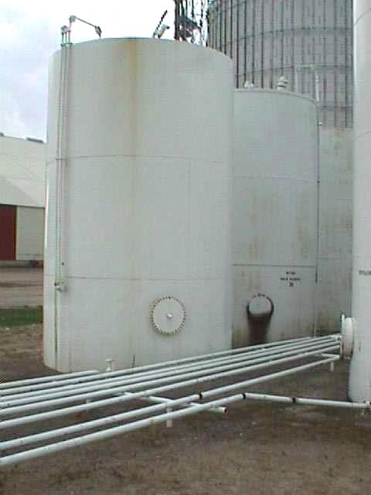
Corrosion Protection for Piping
Steel lines
No soil contact; or
Cathodic protection; or
Double walled
Notes:
A steel line must be protected from external corrosion using one of these methods:
the line is not in contact with the soil;
the line is cathodically protected; or
the line is double walled

Slide 21
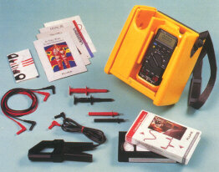
Protect from corrosion if cathodic protection
Monitor
Qualified tester
Within 6 months of installing & every 3 years after
Impressed current systems need to be
inspected every 60 days for proper functioning.
Notes:
Monitoring Corrosion Protection Systems:
Use a qualified cathodic protection tester. Person testing must be able to demonstrate an understanding of the principles of corrosion.
All cathodic protection systems must be tested pursuant to the National Association of Corrosion Engineers (NACE) RP-02-85 code of practice.
Test the cathodic protection system within 6 months of installation and
every 3 years thereafter.
ALSO
Impressed current systems must be inspected for proper function every 60 days (by checking the rectifier).
If you find through monitoring, that the corrosion protection system is inadequate, take corrective action within 180 days.

Slide 22

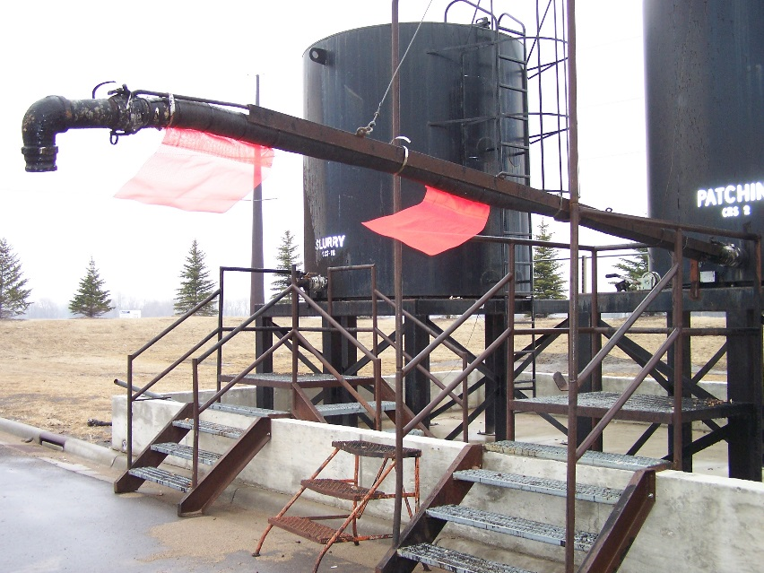
Overfill Protection on Petroleum Single Wall
Automatic shut off or
High level alarm or
manual gauge during transfer (most typical)
STOP
Notes:
Overfill Options:
High-level alarm at max 95% tank capacity or
Automatic shut-off at max 95% capacity or
Permanently mounted sight glass or gauge that is visible to the person controlling the transfer OR manually gauging the tank during transfer and in contact with the person controlling the transfer.
*If using a level stick, sight gauge or gauge that does not read in volumetric measurements, you also need a clearly labeled conversion chart. The chart needs to include the capacity of the tank, mount on the tank or tank’s delivery manifold and be visible to the person controlling the transfer.
Exclusions to overfill requirements:
Tanks that are filled with transfers of 55 gallons or less at one time.

Slide 23
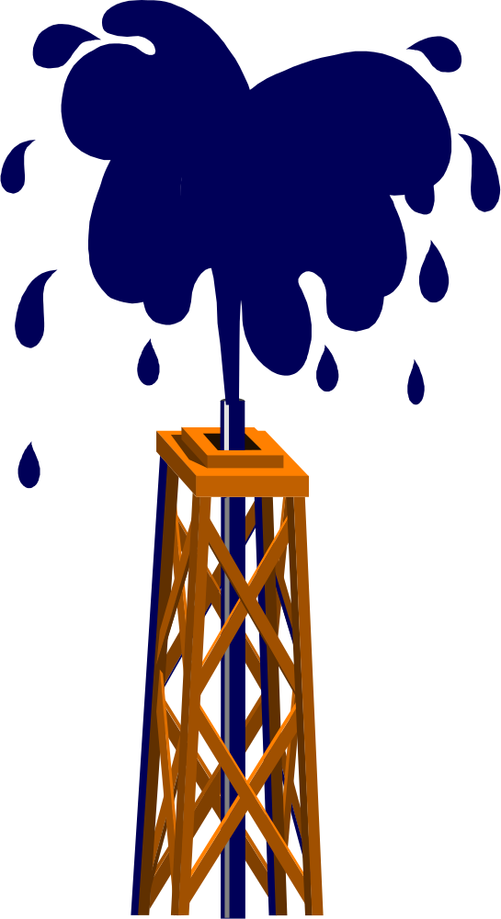
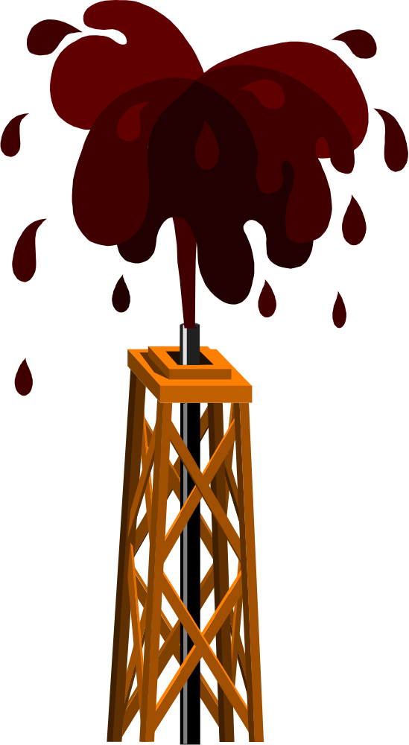
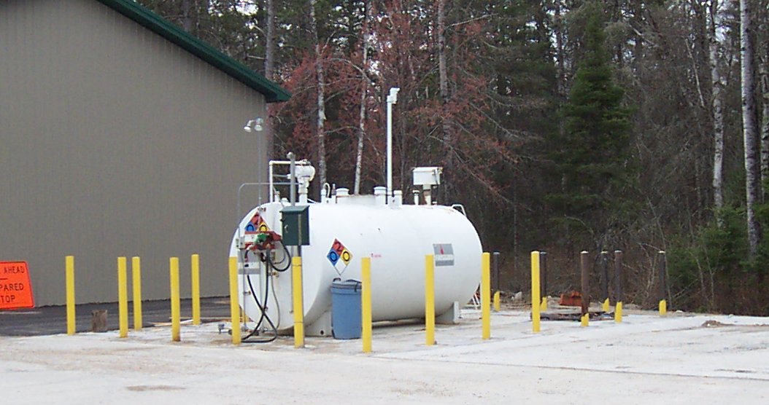
Overfill Protection on Petroleum Double Wall
High level alarm or
Automatic shut-off or
Within additional secondary containment
STOP
Notes:
Since a release from a double-walled tank would be outside the containment area, only these two options are allowed:
High level alarm (set at 95% of the tank’s capacity)
Automatic shut off (set at 95% of the tank’s capacity)
If the double-walled tank is located in an approved containment area, then the alternative methods of overfill protection (site gauge or manual gauging) are acceptable.

Slide 24
Inspections (Monitoring)
NOT required (but recommended) for:
Indoor tanks,
500 gallons or less,
or
Temporary
(unless SPCC)
Notes:
Tanks that are not required to perform standard monitoring and leak detection include tanks with a capacity of 500 gallons or less and temporary tanks.
However, monitoring and leak detection is recommended for these tanks.

Slide 25

Monitoring all product transfers
A trained MnDOT employee
must observe every load/unload
Notes:
At least one person must be present during substance loading or unloading to the tank in order to visually monitor and terminate the transfer when the tank capacity has been reached or in the event of an emergency.
If product is lost, then the tank owner and operator needs to recover all contaminated soils and any product that was released during the transfer.

Slide 26
Periodic Inspections
Over 500 gallons of any product:
  Check tank system
  Containment area
  Substance transfer area
Weekly on single-walled indoor w/o containment or outdoor with secondary containment (emulsion)
Monthly on outdoor double-walled (Lube cube)
Annual equipment check
Notes:
Annual equipment check:
When performing an annual equipment check, check to make sure that all equipment that is used for tank safeguards is functioning; if it isn’t, fix it!
Check equipment for proper function or calibration according to Manufacturer’s recommendations or annually -- which ever is more often.
Records of the inspections should be kept for 3 years.

Slide 27
Keep records
Document :
Maintenance/repair
External and internal inspections
3rd-party certification
As-built drawings
Corrosion protection
All of this information is in and should be kept in your compliance books or maintenance software.
Tank System
Design (for life)
Notes:
Keep these records for the life of the tank:
Maintenance and repair documentation
Third-party certification of tank system equipment
As-built drawings (required for all field-erected tank installations)
External and internal inspections

Slide 28
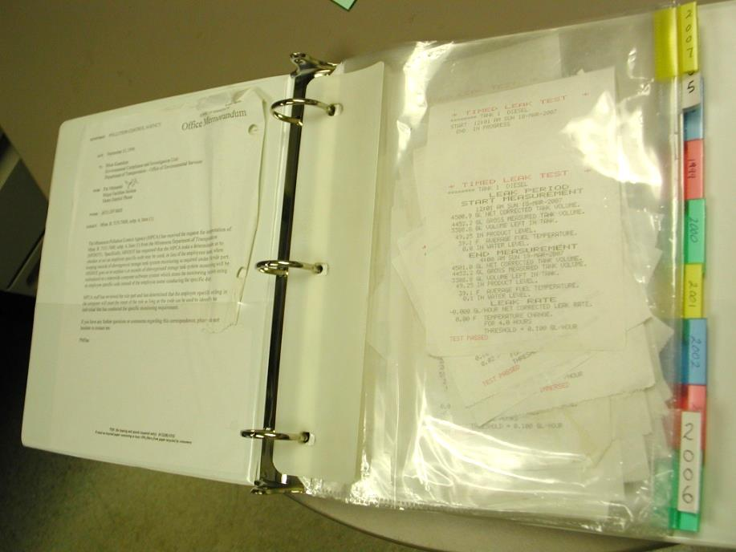
Keep records
Monitoring
(3 yrs)
Periodic inspections
  Visual inspections (record date, person doing inspection, and findings)
Equipment checks/calibration
Out-of-service records
All of this information is in and should be kept in your compliance books or maintenance software.
Notes:
Keep these monitoring records:
For 3 years:
Periodic monitoring (basic information, written)
For 3 years after tank taken out of service:
Records demonstrating compliance with out-of-service tank requirements; include contamination determination records.

Slide 29
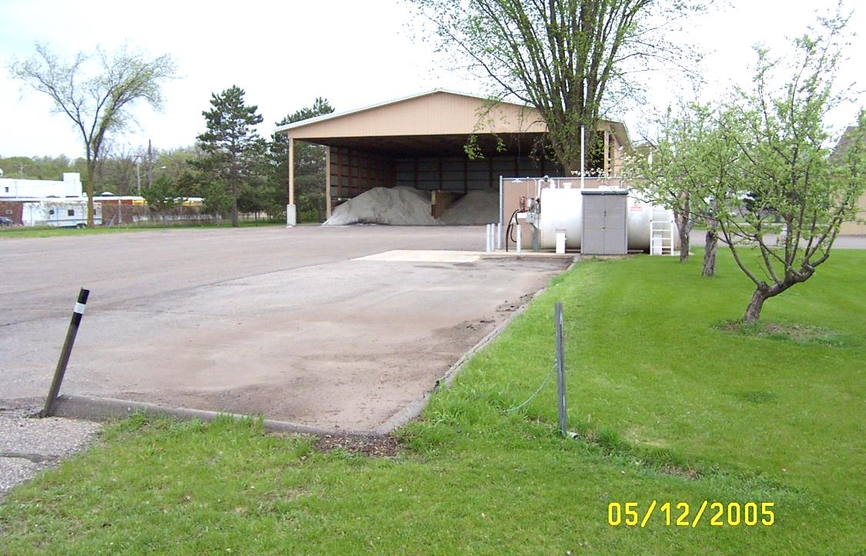
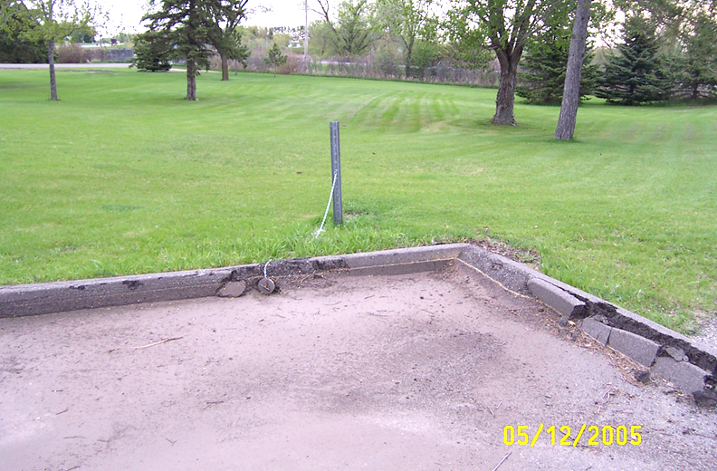
Maintenance
Tank
Transfer area containment
Storm-water discharge
Perform manufacturer’s schedules & standards
Notes:
There are four maintenance requirements that you must meet:
Maintain the tanks
Maintain the containment area
Discharge storm water discharge
Perform scheduled maintenance

Slide 30





Maintaining Tank Containment
NO
Cracks
Open seams
Open drains*
Siphons
Precipitation
Vegetation
Notes:
Secondary containment and substance transfer areas must remain free of:
-Cracks
-Open seams
-Open drains (we allow these in transfer area except when transfer is taking place, must plug) Buffalo truck station had a brine tank shelter with an open drain that was killing shrubbery. Tank containment shouldn’t have any drains.
-Siphons
-Vegetation (other than grass)- can threaten the integrity of the containment area.
-Precipitation that decreases containment volume (If precipitation reduces containment capacity below 100 percent, you must reduce the amount of material in the tank accordingly!)

Slide 31
Special Tanks (Partially Regulated)
Small (500<1100 gallons)
Temporary
Storing “Other Regulated Substances” (deicers)

Slide 32
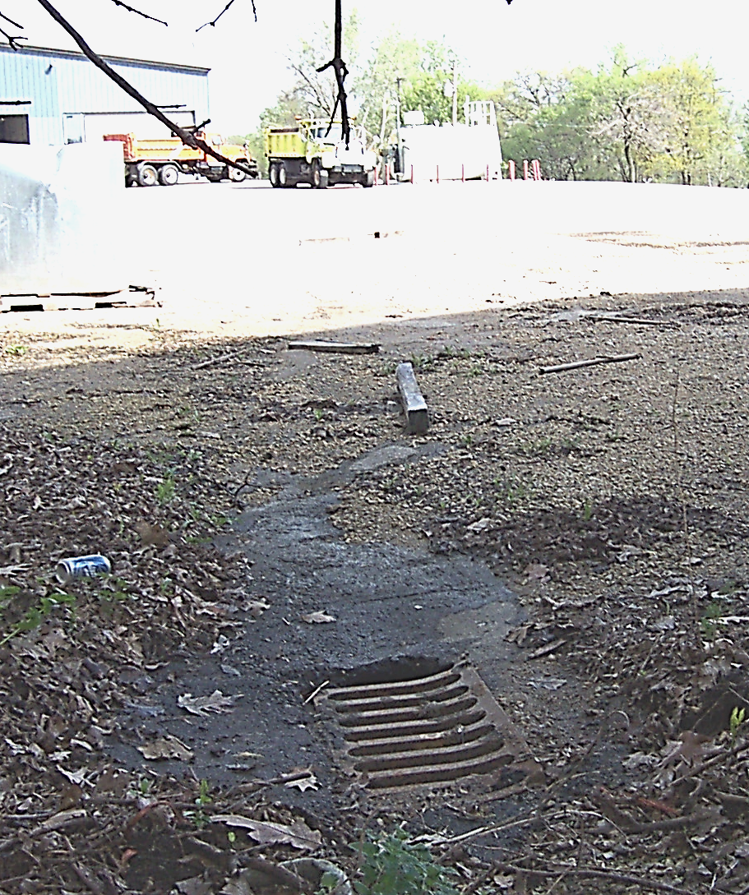
Small Tank Requirements?
Secondary containment
Label
Contact name, address, phone
Sign at facility
500<1100 gallons
Removal/out-of-service procedures
Trained MnDOT observation of all product loads/unloads
Contents
other info
IF within 500 feet of surface water (storm drains)
Notes:
Secondary Containment with adequate volume and permeability.
Labeling of the tanks and lines.
Sign at the facility with a name, address, and phone number of a contact person.
If taking a tank out of service or removing the tank, follow the correct procedure.
Some small tanks are exempt from:
Maintenance requirements (unless they are greater than 500 gallons and within 500 feet of a Class 2 surface water)
Labeling (tanks 500 gallons or smaller and tanks exempt from Minnesota Rules 7151)

Slide 33

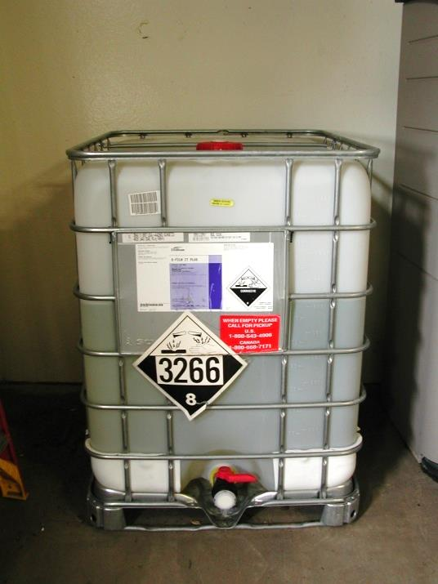
Temporary Tank Requirements?
Secondary containment
Label “Temporary Storage” and start date
Sign at facility
Contact name, address, phone
Maintain containment area
Trained MnDOT observation of all product loads/unloads
30 days <1 year
Notes:
Temporary tanks are tanks that are at a site for more than 30 days but less than one year.

Slide 34
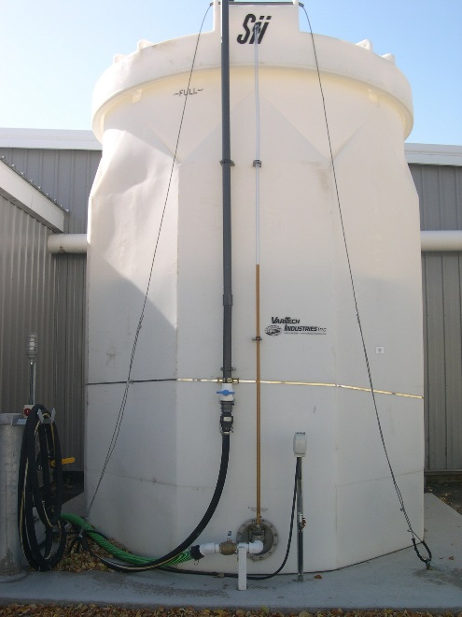
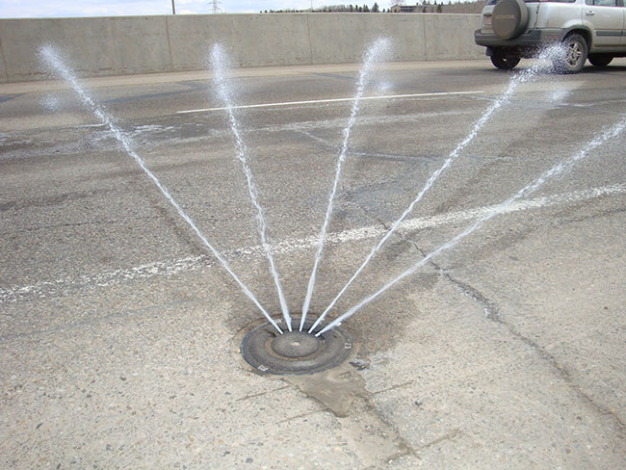
Storing “other regulated substances” (Deicers)
Needs
Secondary containment
Registration
Labels and signs
Monitoring, record keeping, and
maintenance
Trained MnDOT observation of all product loads/unloads
Design approval is recommended
Notes:
“Other regulated substances” require secondary containment, labeling, and signs.

Slide 35
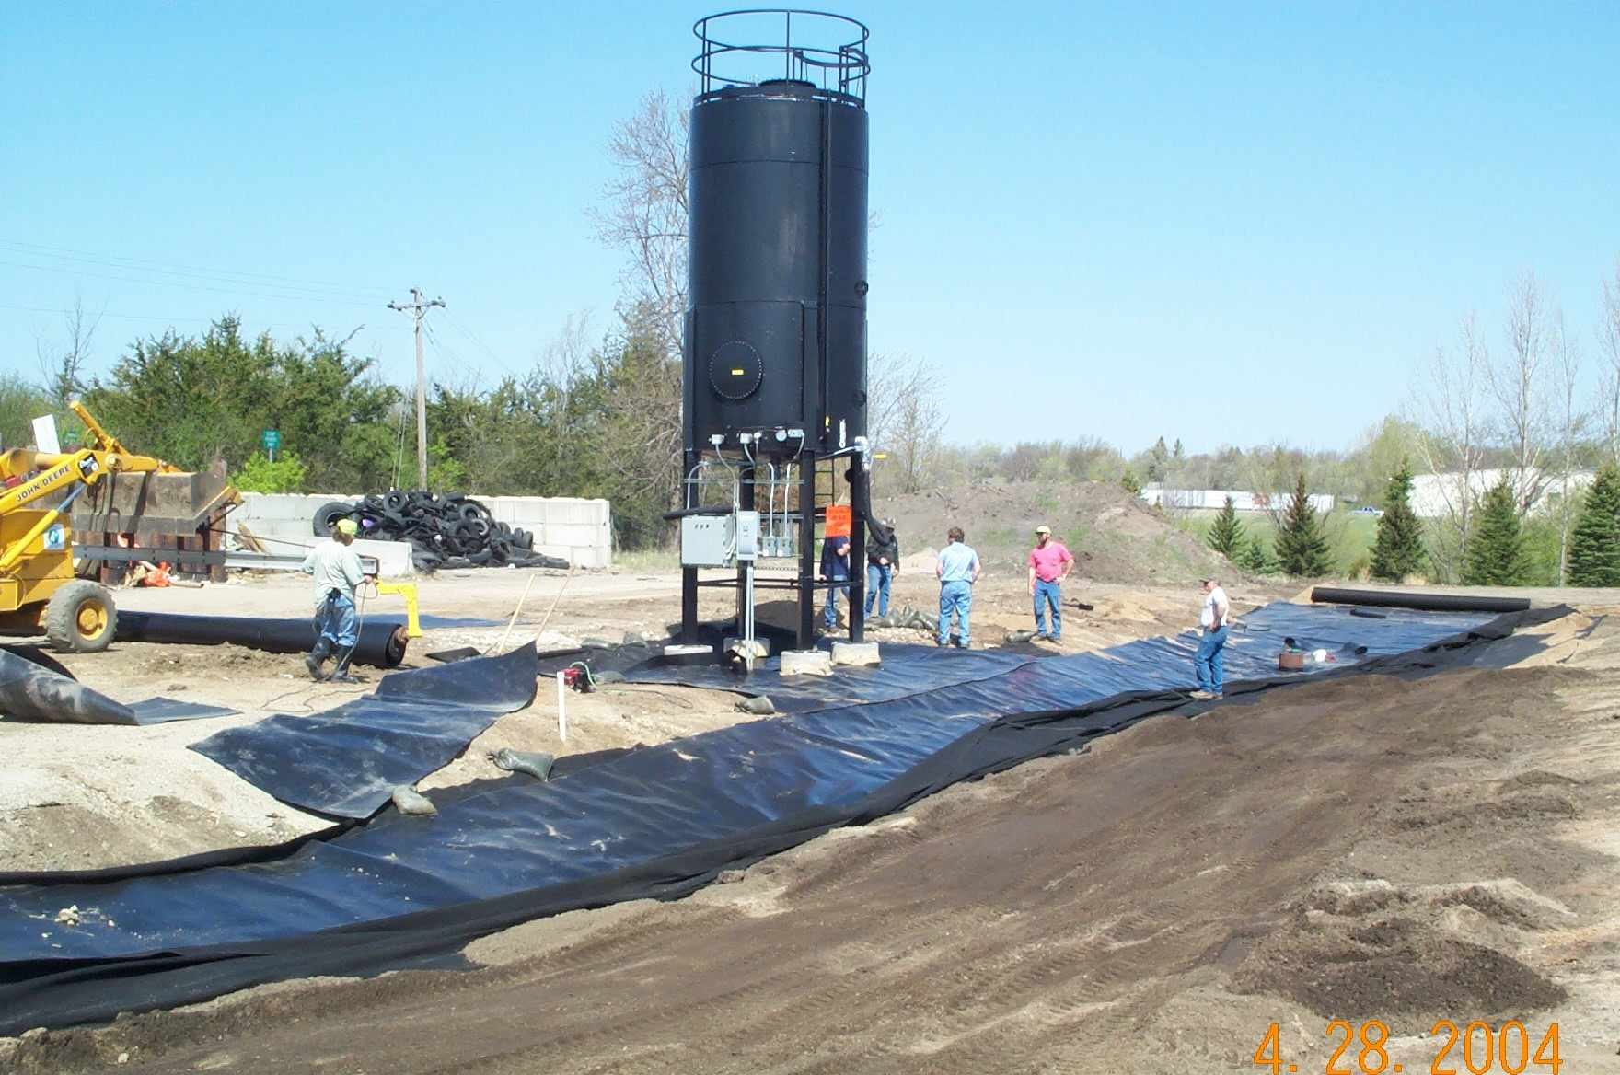
Storing road oil/emulsion
Needs
Registration
Secondary containment
Labels and signs
Monitoring, recordkeeping, and maintenance
Trained MnDOT observation of all product loads/unloads
Design approval is recommended

Slide 36
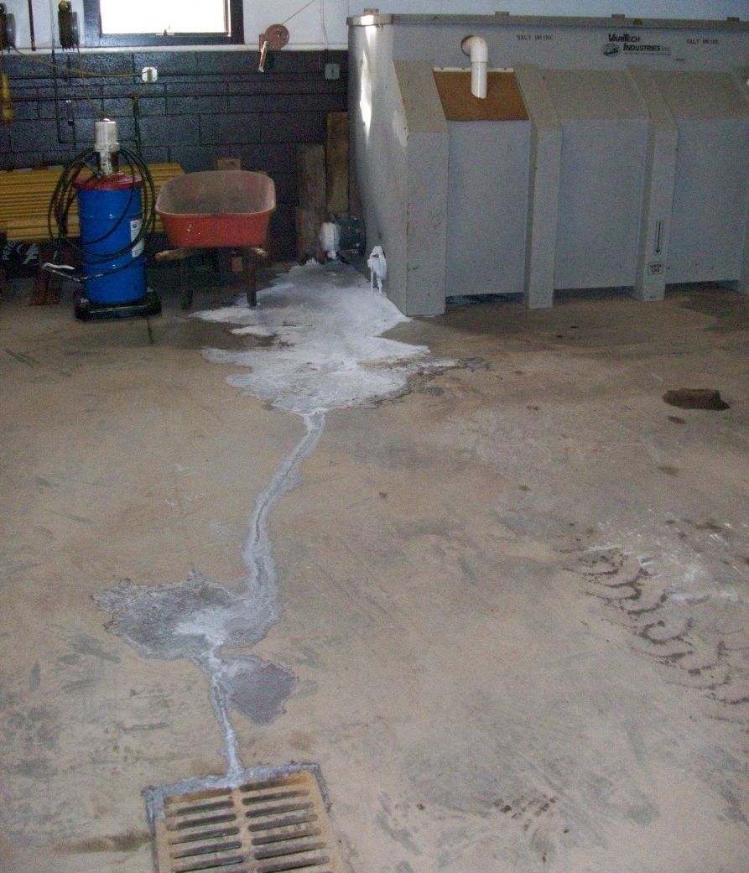
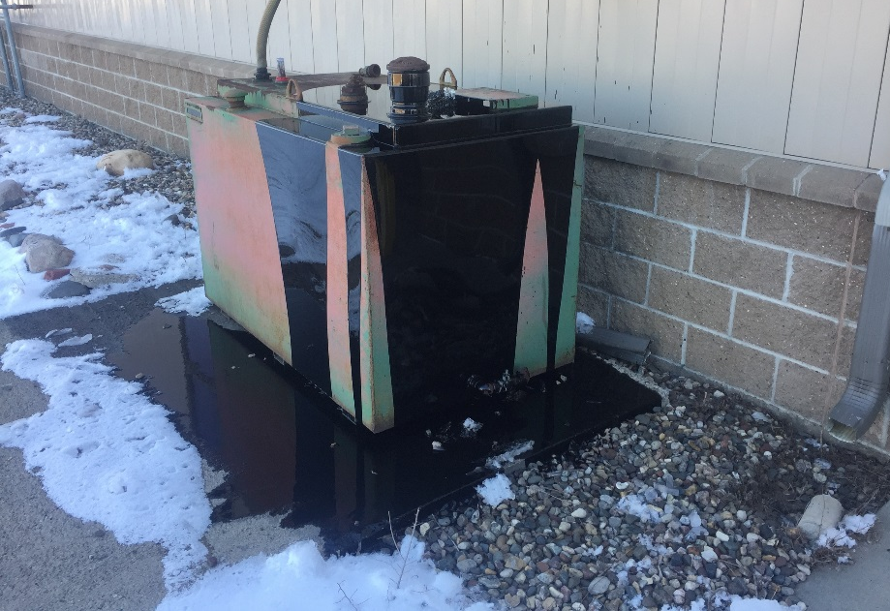
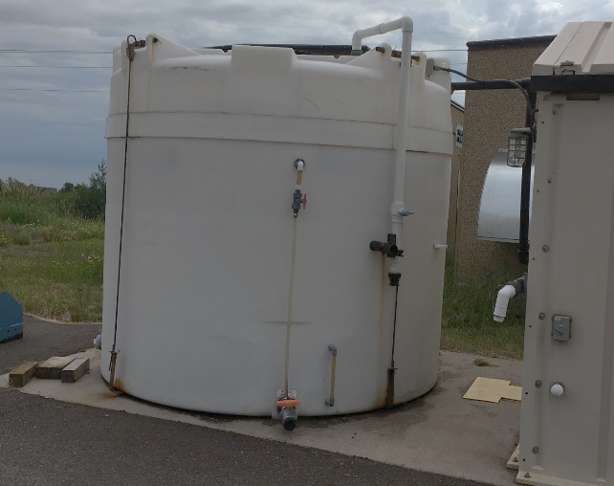
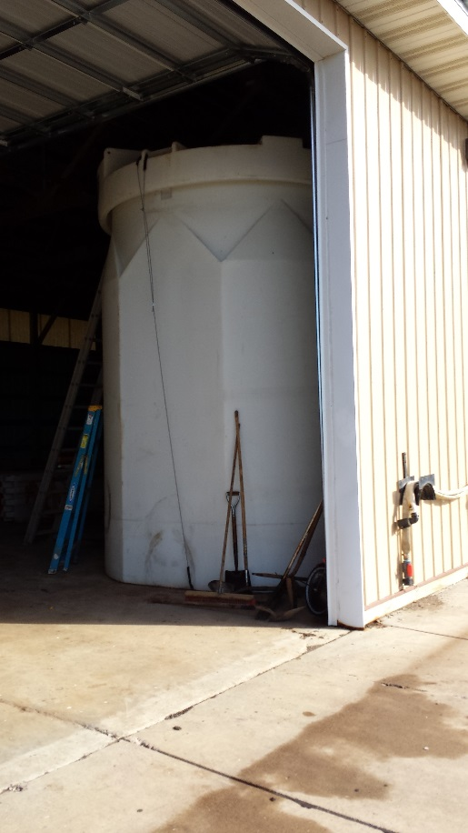
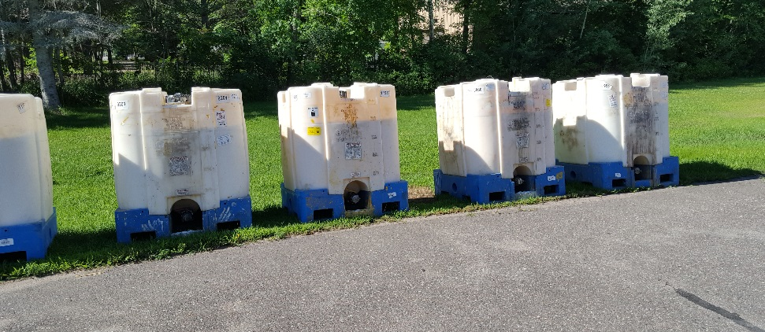

Slide 37
Special Considerations
Taking a Tank Out of Service
Removing a Tank

Slide 38
No longer using?
Substance isn’t added to
or removed from the tank
for a year or more?
Monitor and
Maintain
Declare tank inactive
& take it out of service or
remove it
OR
Notes:
If you are no longer using a tank, you must:
Continue to monitor and maintain according to requirements
OR
Declare the tank inactive and take it out of service or remove it.

Slide 39

Taking a tank out of service
Remove product
Clean interior
Eliminate vapors
Secure
Out of
Service
8/11/17
Label
Notes:
After one year, have to renew, remove, or make active.
f you are taking a tank out of service, you must:
Remove all product from the tank and piping
Thoroughly clean the interior of the tank and piping
Render the tank free of vapors
Secure the AST to prevent unauthorized entry
Label the tank as “Out of Service” with date.

Slide 40
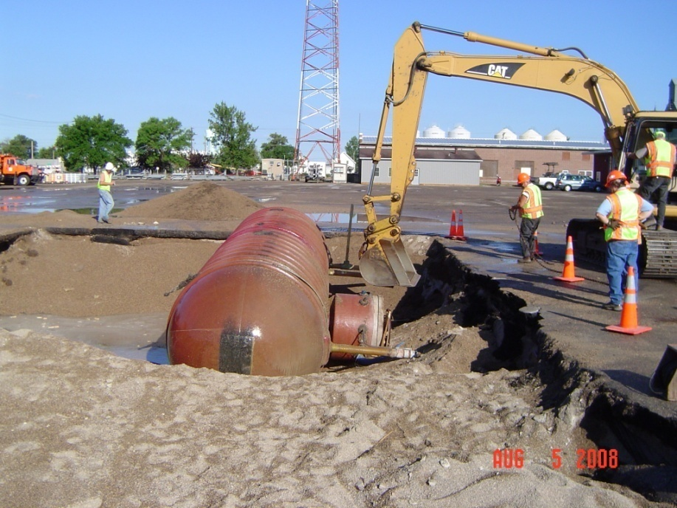
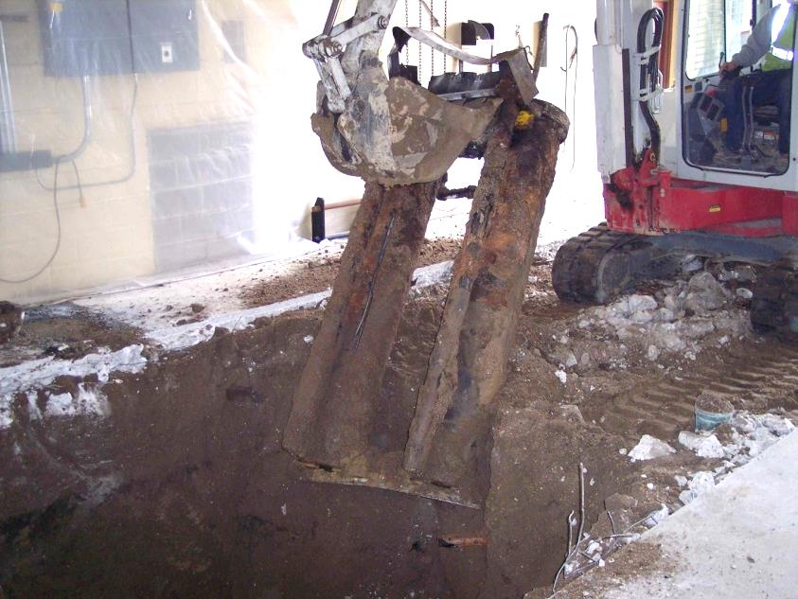
Removing a tank
Soil sampling is ALWAYS required when removing a storage tank
(even if there is no apparent contamination)
  Notify me for deicer tanks

Slide 41
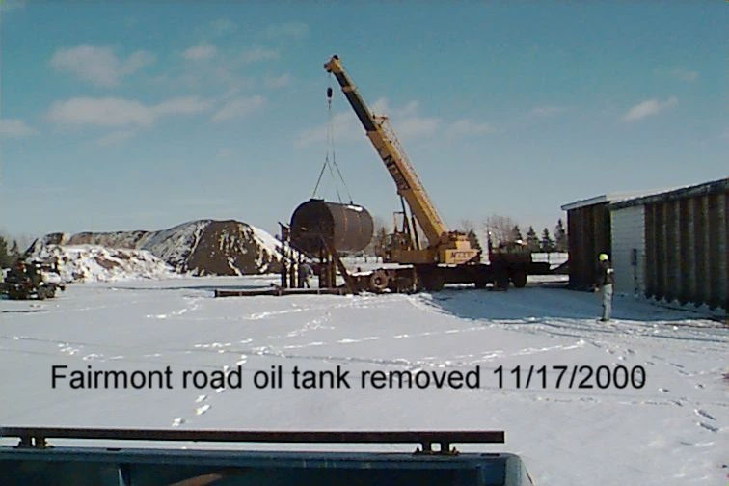
Planning a Tank Removal?
Carolyn Boben
D1, D3, MN, ME
Michelle Waters
D2, D4, MW
Sarah Jarman
D6, D7, D8, MS

Slide 42
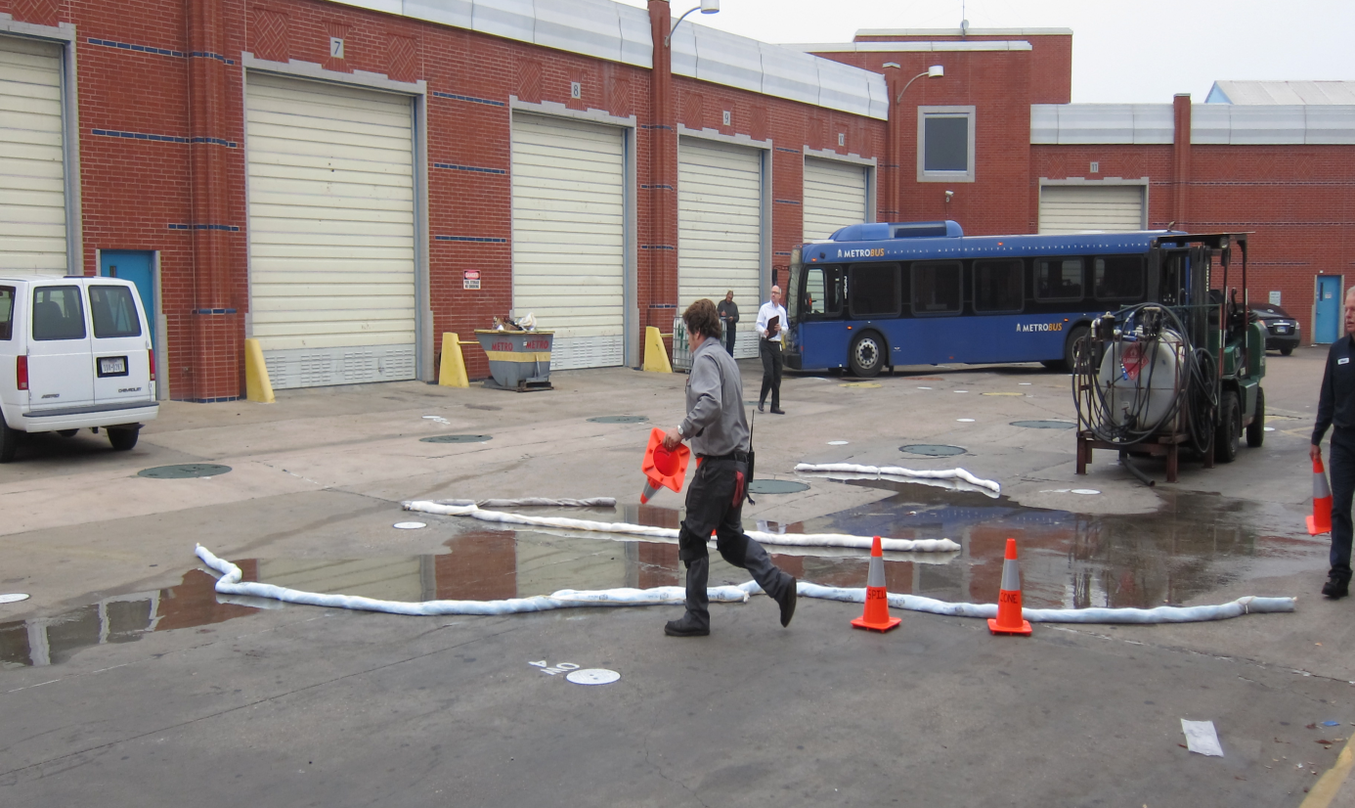
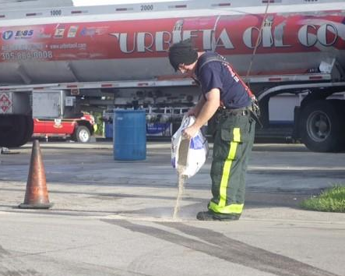
Have a Spill?
Contain as much as possible and notify MnDOT Dispatch 651-234-7110
Petroleum spills less than 5 gallons are not reportable.
Call
Notes:
If contamination is encountered, contact MnDOT dispatch immediately. They are available 24 hours per day.

Slide 43
Other Tank Regulations
State Spill Plan
  if you have between 10,000-1,000,000 gallons of petroleum in ASTs
Spill Prevention, Control & Countermeasures (SPCC Federal Spill Plan)
  Total exceeds 1,320 gallons of petroleum in aboveground 55 gallon containers or larger OR;
  Total underground exceeds 42,000 gallons
Fire Marshal Requirements
  Need tight sheer valve anchor on petroleum dispensers with pressurized piping

Slide 44
Federal SPCC Requirements
Tank system
  Double-walled or diked area
Substance transfer area for AST & UST for loading/unloading
  Blocked drain/storm sewer inlet
  Curb containment w/ drain plug
Security
  Controlled access
  Starter controls
  Lighting
Personnel
  Monthly inspections on all petroleum tanks
  Annual training
  Posted spill event procedure
Written response plan
Notes:
Substance Transfer Area Containment- all parts of a regulated facility with potential for a petroleum discharge (AST or UST) are subject to the general secondary containment requirements, which is “appropriate containment” must hold the most likely oil discharge from areas or containers until cleanup occurs.
Spill buckets on UST
Spill kits on islands or nearby
Controlled access: locked gates, fencing
Lighting: discourage vandalism, increase visibility for night operations
Monthly inspections: tank system, transfer area
Spill event procedure: facility posting

Slide 45
Other Regulations —
State Fire Marshal
What?
Compliance with Minnesota State Fire Code
Regulates facilities by activity and type of liquid to ensure fire preparedness
Why?
Who?
For more information: www.fire.state.mn.us
e-mail: firecode@state.mn.us
Notes:
A Site Plan, reviewed by the local fire marshal, is required for:
ASTs holding Class 1 liquids (such as gasoline)
ASTs dispensing Class 1 or 2 liquids (gasoline and diesel) to motor vehicles, aircraft or water craft
No Site Plan review is required for ASTs holding Class 3 liquids (such as motor oil, hydraulic oil, glycol or vegetable oil)

Slide 46
Summary
Storage Tank Website
http://ihub/tank/
  District Tank Inventory, Compliance Manuals, and Tank Guidance Documents
  Summer Allen-Murley, 651-366-3635

Slide 47
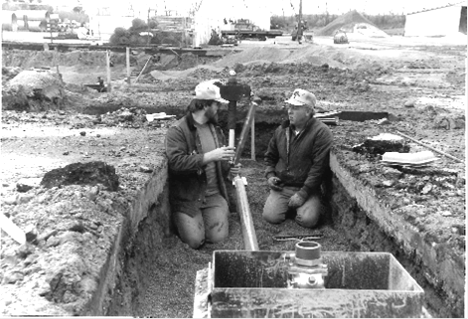
Underground Storage Tanks (USTs): What we’ll cover
Types of USTs
Registration
Leak detection
  Tank
  Piping
Overfill Protection
Spill Protection
Corrosion Protection
Tasks & Documentation

Slide 48
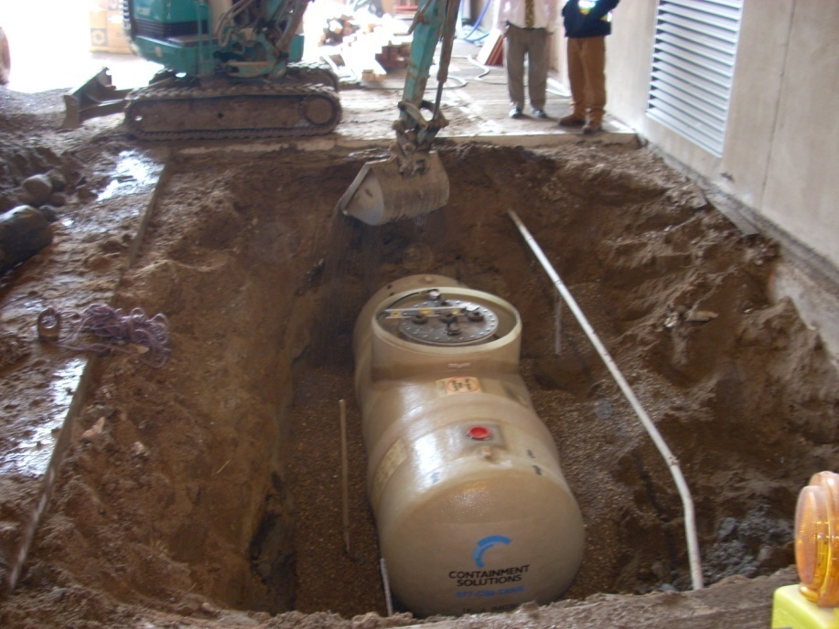
Types of Underground Storage Tanks and Registration
Diesel/Gasohol fuel
Fuel oil
Heating oil
Wastewater
All petroleum tanks over 110 gallons must be registered with the MPCA and will be inspected by MPCA every 3 years

Slide 49
UST Leak Detection

Slide 50
Pipe Leak Detection
Safe Suction
  Interstitial, sump sensors & ATG
Pressurized
  Interstitial, sump sensors & ATG PLUS
  Line leak detectors with annual testing OR
  Program sump sensors for total shut down in the event of minimum 3 gal/hr. leak

Slide 51
UST Overfill, Spill and Corrosion Protection

Slide 52
UST Tasks
  Daily: At least one properly trained MnDOT staff person will be present for every substance loading/unloading event at all locations.
    If the location is regulated under SPCC, appropriate transfer containment must be used.
Monthly
  Collect one ATG passed test for each tank
  Activate alarm for ATG/monitoring system
  Check dispensers for leaks
  Check all sump sensors for moisture and remove as necessary (replacement by certified contractor)
  Check tightness of sheer valve anchor (pressurized piping)

Slide 53
UST Tasks
Annual
  Complete performance test of ATG and monitoring system (repair by certified contractor)
  Test line leak detectors (by certified contractor)
  Check interstitial sensors and replace if necessary (replacement by certified contractor)

Slide 54
UST Tasks
As Needed
  MPCA 10-Day Advance Notification of Installation, Closure, or Lining Inspection of Tanks, Piping, or Dispensers
  MPCA 30-Day Post Notification of Installation, New Information, or Closure of Tanks, Piping, or Dispensers
  When MPCA/County tank inspector visits every 3 years, call Supervisor and/or Safety Admin.

Slide 55
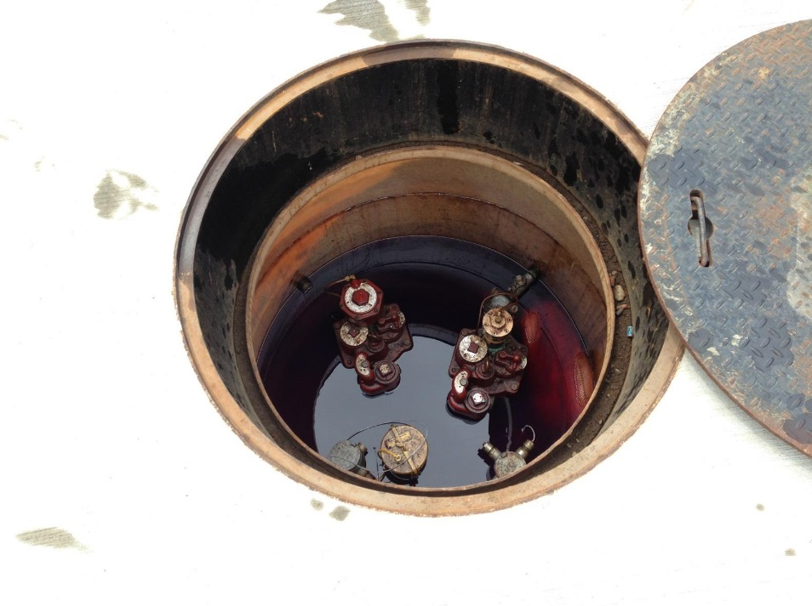
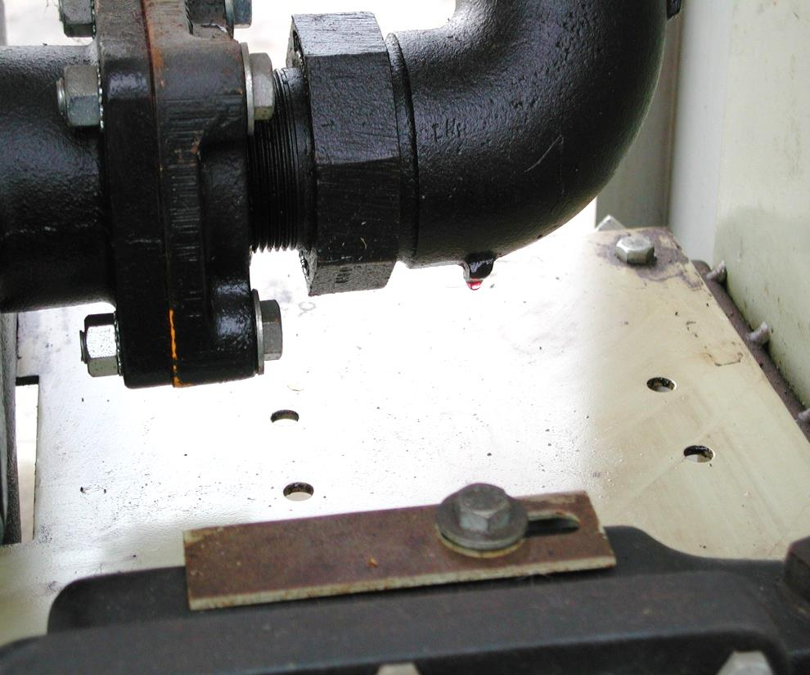
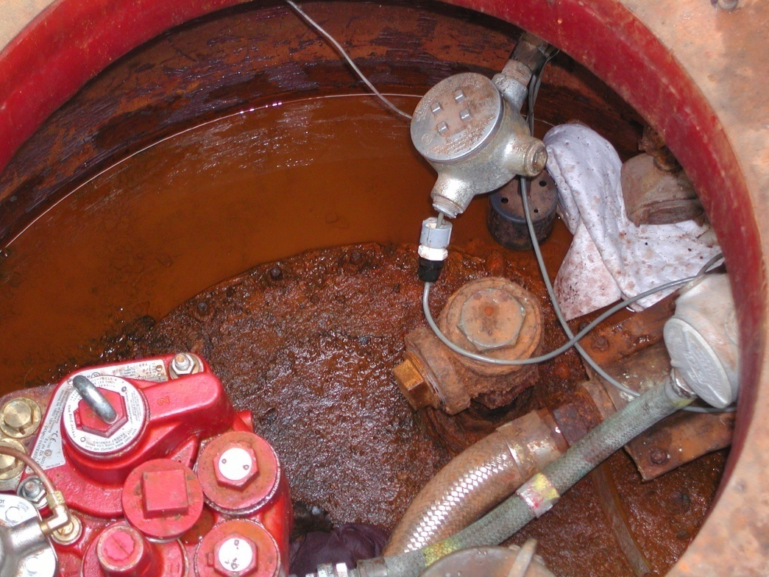
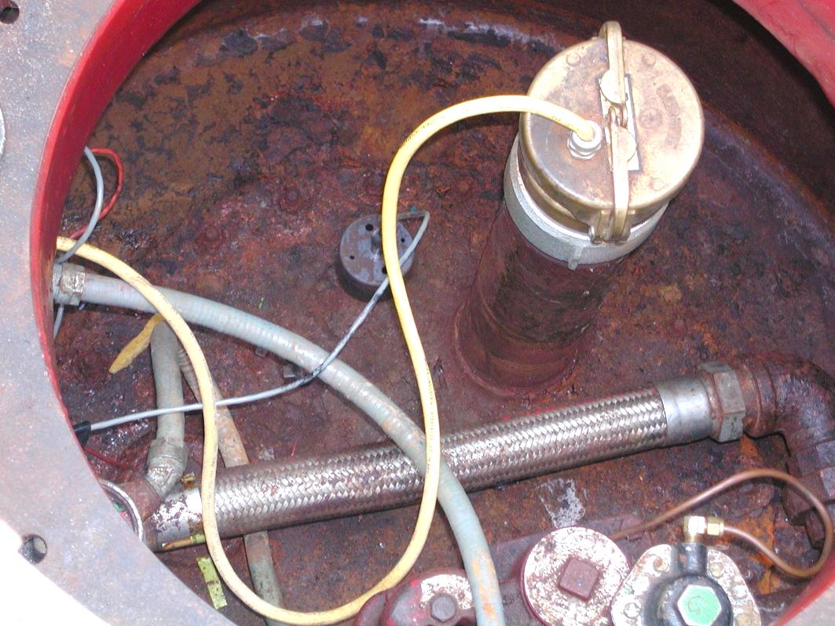
Notes:
Diesel leak, diesel drip, broken sump sensor connection and water in bottom, sump sensor sitting on bottom

Slide 56
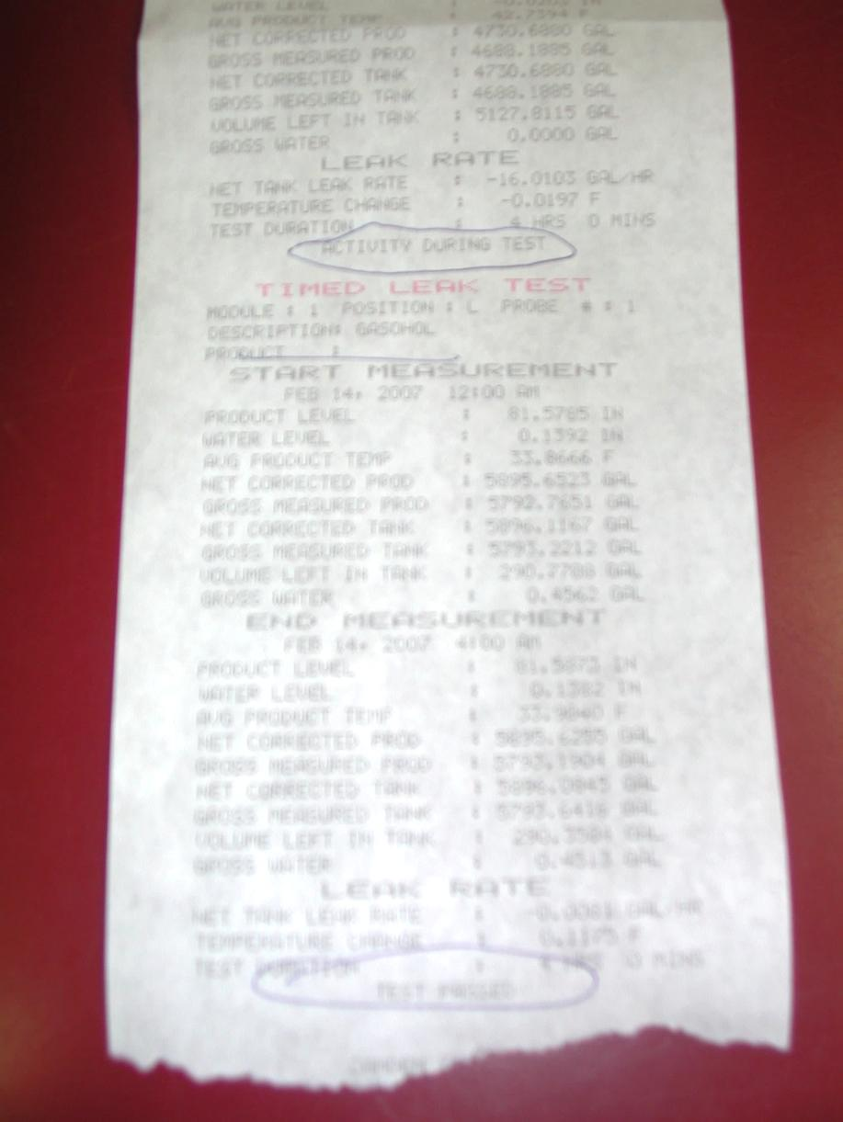
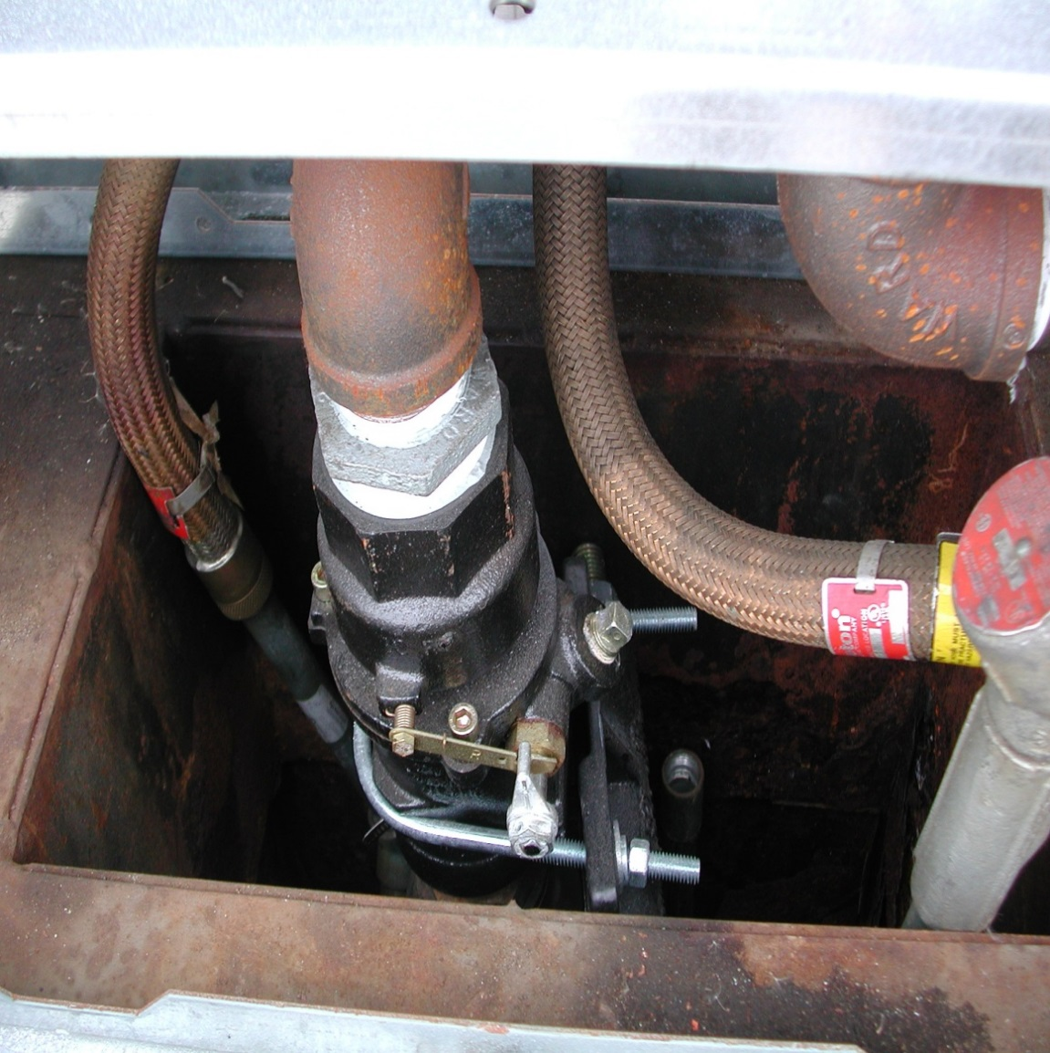
Notes:
ATG monthly test (activity during test, test passed), sheer valve anchor (keep tight)

Slide 57
UST Documentation
Kept for 10 years
  Monthly ATG test results
  Inspection activities
  Compliance with manufacturer maintenance schedule
  Sensor replacement
Kept for life of tank
  Owner/Operator Training Certificates
    3 classes of tank operators (A,B,C)
  MPCA registration & notification forms
  SPCC Plan if total UST exceed 42,000 gallons
  All repairs
  All written performance claims

Slide 58
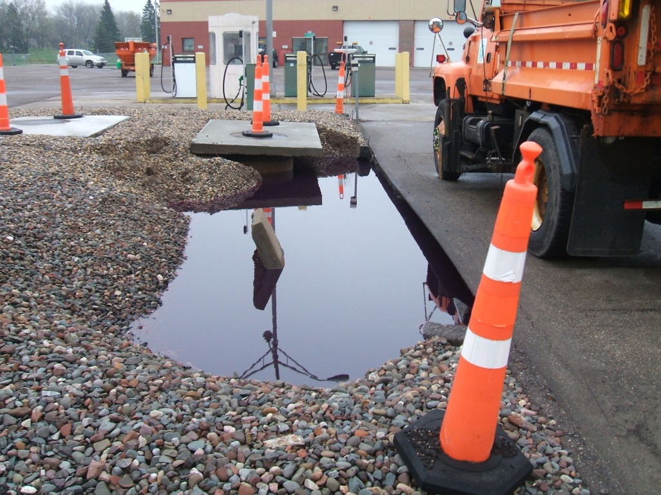
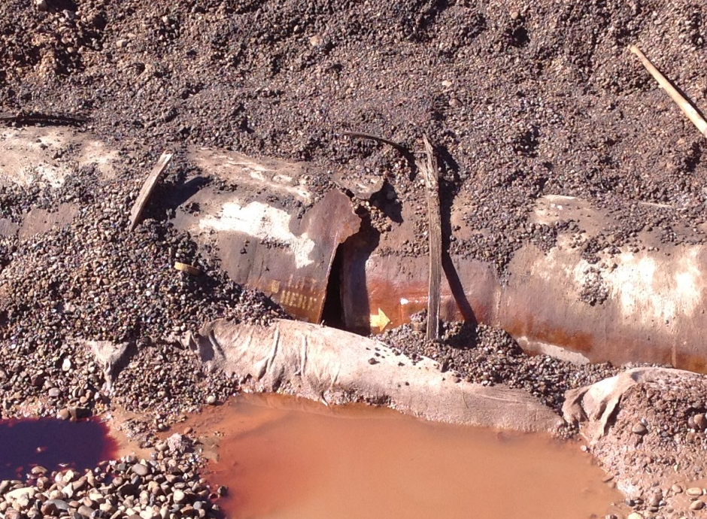
UST Personnel
Familiar with tank system components
Familiar with compliance documentation
Spill event procedure
Notes:
Must be able to walk with inspector and be familiar with equipment and where the records are kept

Slide 59
Recent UST Rule Changes

Slide 60
Summary
Storage Tank Website
http://ihub/tank/
  District Tank Inventory, Compliance Manuals, and Tank Guidance Documents
  Summer Allen-Murley, 651-366-3635

